Slide 1
Marketing Lecture # 3 Muhammad asad Instructor department of computer science

Slide 2
Key Learning Point :-
- Discussion about importance of consumer behavior

Slide 3
CONSUMER BEHAVIOR
The study of consumers and the processes --- They use to choose and consume goods and services, including consumer’s emotional, mental, and behavioral responses.

Slide 4
IMPORTANCE OF CONSUMER BEHAVIOR
Every consumer has a different thought and attitude towards buying a particular product --- Because --- Consumers around the world differ in age, income, education level, and tastes --- If a company fails to understand the reaction of a consumer towards a product, there are high chances of product failure.
Due to the changing fashion, technology, trends, living style, income, and similar other factors, consumer behavior also changes --- A marketer has to understand the factors that are changing --- So that the marketing efforts (marketing mix) can be aligned accordingly.

Slide 5
Understanding consumer behavior is important for any organization before launching a product --- If the organization failed to analyze how a customer will respond to a particular product, the company will face losses.
The sad truth is that most new products and new ideas end up in failure. There is an estimate of new product failures – they range from 33% to 90% based on the kind of industry.

Slide 6
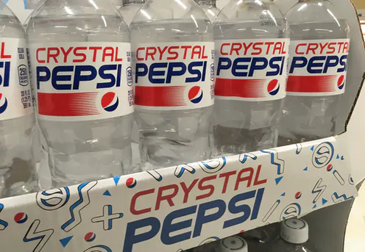
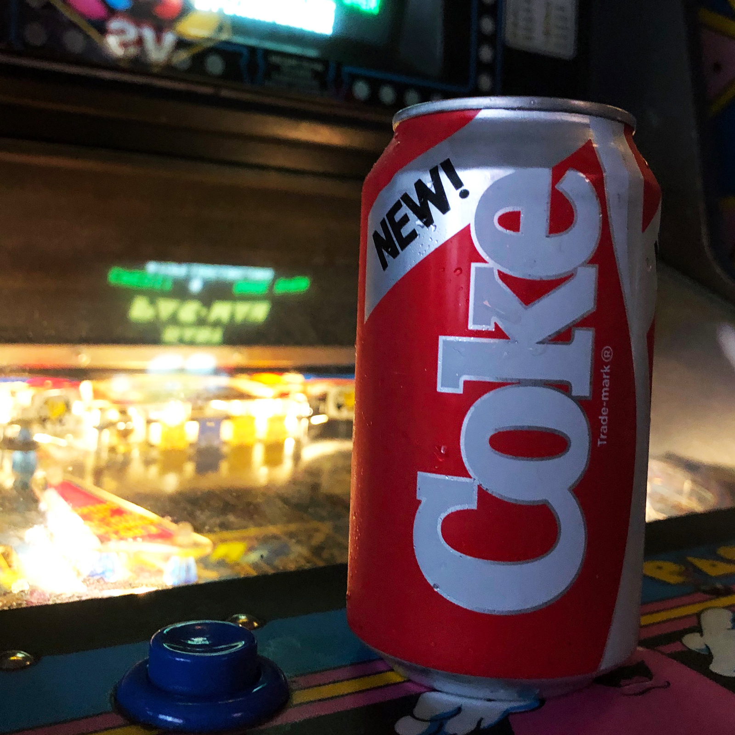


Companies consistently fight hard to improve the success rate of their new products or new ideas. One of the most important ways is to conduct sound and thoughtful consumer behavior study.
We all know some of the big names such as
New Coke Crystal Pepsi Colgate Kitchen Entrées Wheaties Dunk-a-Balls Cereal
Can you see the similarities in these products? Yes, they all failed!!

Slide 7
Consumer behavior analysis an important tool to understand your customers --- By looking into consumer psychology and the forces behind customer buying behavior --- Companies can build new products, marketing campaigns and increase profitability.

Slide 8
NIKE
With the help of consumer behavior analysis, Nike realized that most of its target audience is not professional athletes --- But many of them were striving to be more like them.
So at the 2012 Olympics in London, Nike introduced a campaign to encourage athletics called ‘Find Your Greatness’.
It aimed to promote the aspirations of being an athlete, not just with high-performing athletes, but wanted to include all people regardless of their physical capability.

Slide 9

This message inspired many consumers and had huge demand for target consumers.

Slide 10
LENOVO UNDERSTANDING CUSTOMERS AND BUILDING PROFITABLE RELATIONSHIPS
Lenovo was established in Beijing, China, in 1984 by 11 members of the Computer Technology Research Institute. Originally founded as “Legend Holdings” and changed its name to Lenovo in 2004 to expand internationally.
In 2005, the company acquired IBM’s personal computer business, including the ThinkPad laptop and tablet lines. In 2015, Lenovo was the world’s third-largest personal computer seller --- By unit sales and had operations in more than 60 countries, with products sold in around 160 countries.

Slide 11
The global success of Lenovo is based in its deep and sound understanding of customers and its ability to build profitable relationships. The business model is built on customer satisfaction, innovation, and operational efficiency.
Lenovo’s marketers spend a great deal of time thinking about customers and their buying behavior --- They want to know
Who their customers are? What do they think?
How do they feel about the products What makes them satisfy?
In order to arrive at comprehensive answers to these questions --- Lenovo’s product design and engineering teams listen to their customers --- Through their social media channels, forums, blogs, and fan clubs around the world.

Slide 12
The company highly values the input of its customers and tracks it accordingly.
REAL WORLD EXAMPLE
After Lenovo had introduced new variants of its Lenovo ThinkPad series in 2012 and 2013 --- Customers complained on internet forums --- That the two physical Track-Point buttons had been removed from the touchpad, at the bottom of the keyboard.
These buttons correspond to the left and right mouse buttons on a conventional mouse and work as a substitute to an external mouse or touchpad.

Slide 13
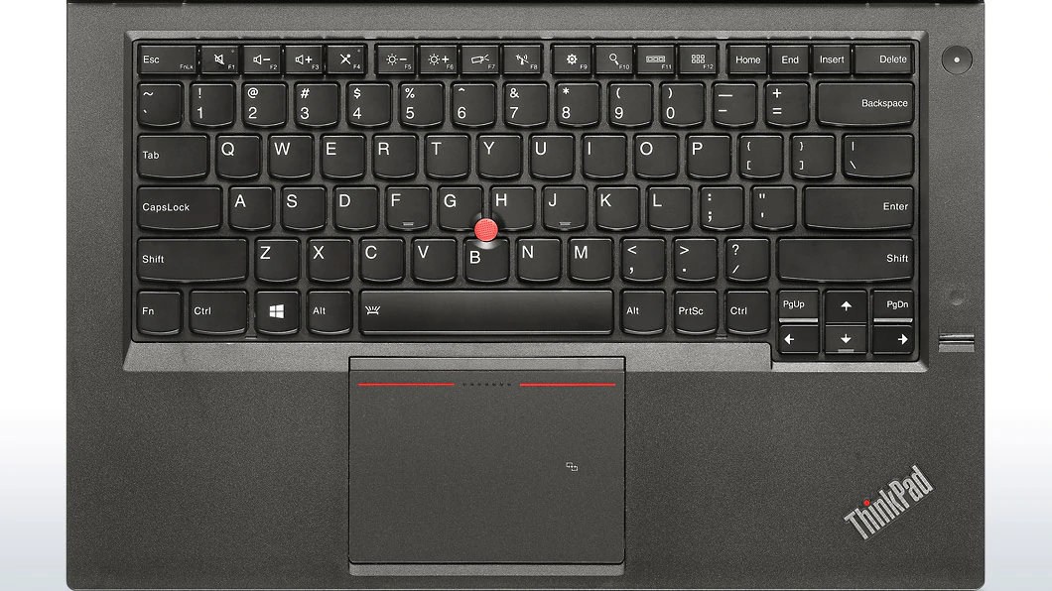

Slide 14
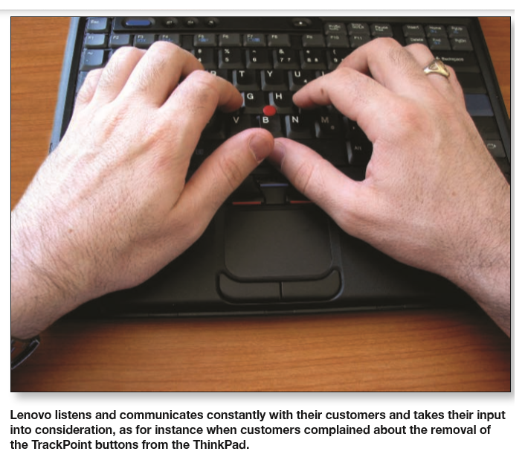
Lenovo soon realized this issue - Publicly admitted that they had made a big mistake
Soon afterwards, brought back the Track-Point buttons.

Slide 15
MODEL OF CONSUMER BEHAVIOR
Companies research consumer buying decisions in detail to answer questions about --- What consumers buy, where they buy, how and how much they buy, when they buy, and why they buy.
But learning about the whys --- Behind consumer buying behavior is not so easy --- The answers are often locked deep within the consumer’s mind.
How do consumers respond to various marketing efforts (marketing mix) the company might used --- Stimulus-response model of buyer behavior.

Slide 16
The consumer’s “black box” means --- What takes place in the consumer's mind to produce certain responses (after observed environmental change).
Marketers want to understand --- How change in environmental factors --- produce responses inside the consumer’s black box.
Which has two parts…
First, the buyer’s characteristics influence how he or she perceives and reacts to the environmental change. These characteristics include a variety of cultural, social, personal, and psychological factors.

Slide 17
Second, the buyer’s decision process itself affects his or her behavior. This decision process start from need recognition, information search, and alternative evaluation to the purchase decision and post purchase behavior (begins before the actual purchase decision).

Slide 18
THE ENVIRONMENT
MARKETING MIX
Product
Price
Place
Promotion
OTHER
ECONOMIC
Technological
Social
Cultural
We can measure the whats, wheres, and whens of buyer behavior. Such as apple introduce a new ITouch device and feature it in TV ads – and we can measure the output of consumer buying decision. Like 20,000 customers buy the new device at the company’s website within a week of introduction.
BUYER RESPONSES
BUYING ATTITUDES AND PREFERENCES
PURCHASE BEHAVIOR
(what the buyer buys, when, where, and how much)
BRAND ENGAGEMENTS AND RELATIONSHIPS
BUYER’S BLACK BOX
BUYER’S CHARACTERISTICS
BUYER’S
DECISION PROCESS
But it’s difficult to “see” inside the consumer’s head and ﬁgure out the whys (that’s why it’s called the black box).
We look first at buyer characteristics as they affect buyer behavior and then discuss the buyer decision process.

Slide 19

ANY QUESTION
You can contact me at: asadali@uosahiwal.edu.pk
Your query will be answered within one working day.

